Slide 1

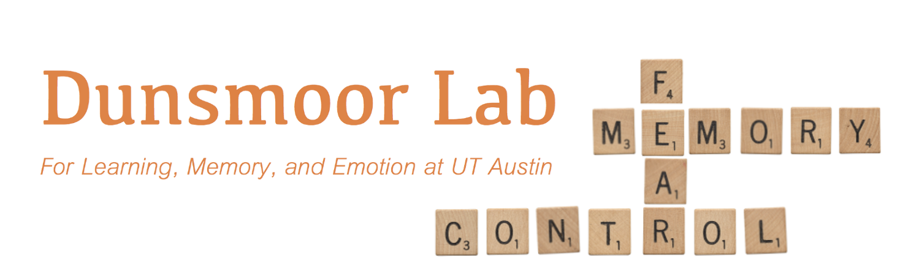
Dissociable neural reinstatement of emotional memories in human PFC
Augustin Hennings
Dunsmoor & Lewis-Peacock Labs
CAM joint lab meeting 5/6/19

Slide 2
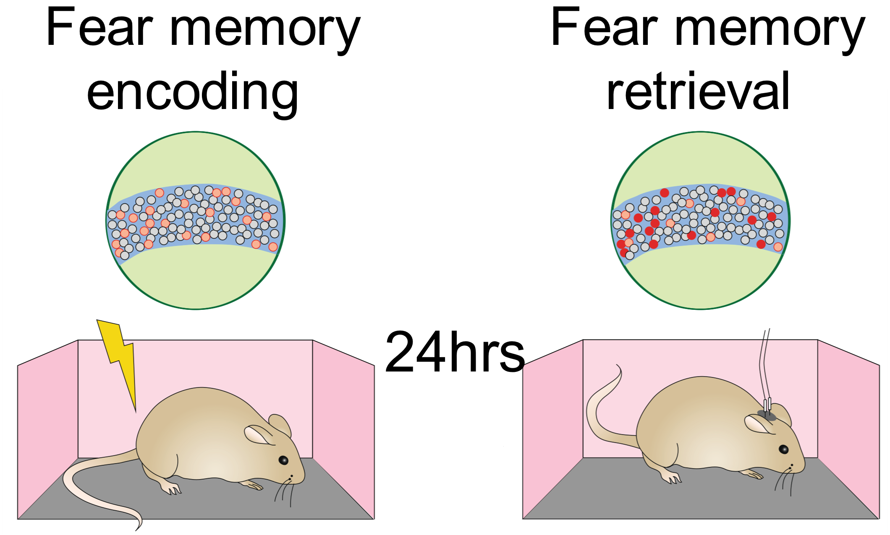
Specificity of neural coding
The neural circuits which encode a memory reactivate during retrieval
Fear and extinction engrams are stable and separable, in rodents
Strength of reactivation predicts behavior
1
Frankland et al., 2019 Nat. Neurosci.
Notes:
This is the idea of encoding specificity, first posited by Thompson & Tulving
Research into the learning of conditioned fear and extinction has been able to demonstrate this principle to great success in rodents – and we now know that fear and extinction memories exist as stable and separable engrams
have real consequences for behavior
What is an engram – dissociable neural code

Slide 3
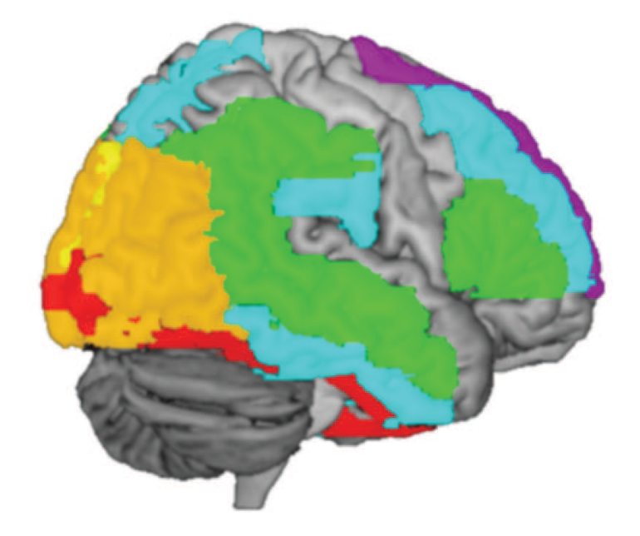
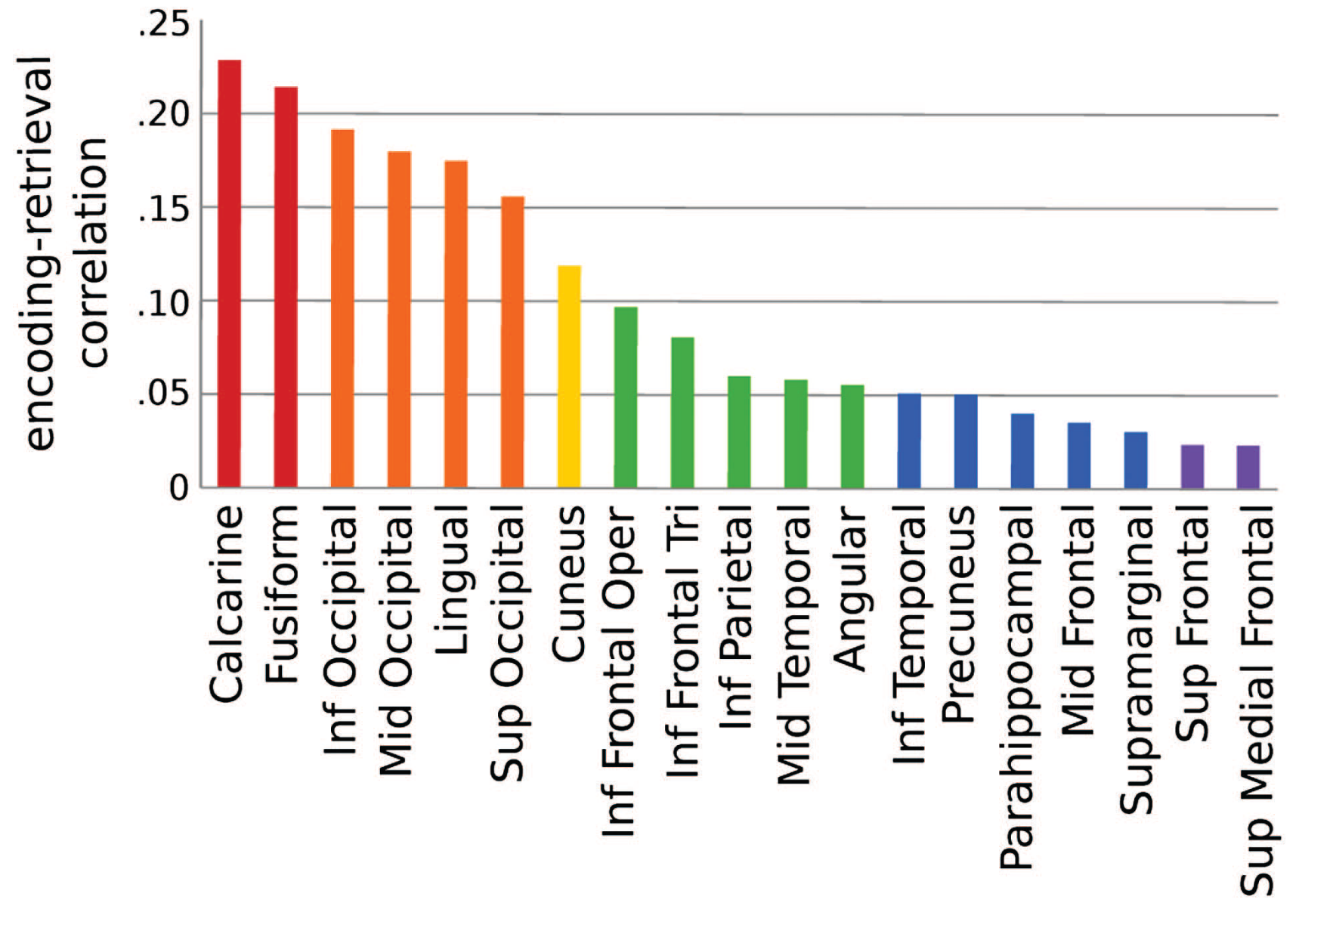
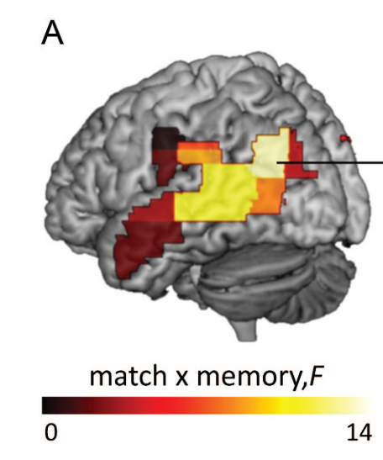
Reinstatement in the human brain
Encoding Retrieval Similarity (ERS)
Measure overlap of neural activity from encoding to retrieval
Neural circuits : spatial patterns of neural activity
The fidelity of memory reactivation influences behavior
Item-level reactivation in cortex
Item-level reactivation predicts memory
Ritchey et al., 2013. Cereb. Cortex
Notes:
Say this when for the first picture – this Provides evidence for neural reinstatement in humans
Be smarter introducing these figures – its real data
Cover A up

Slide 4
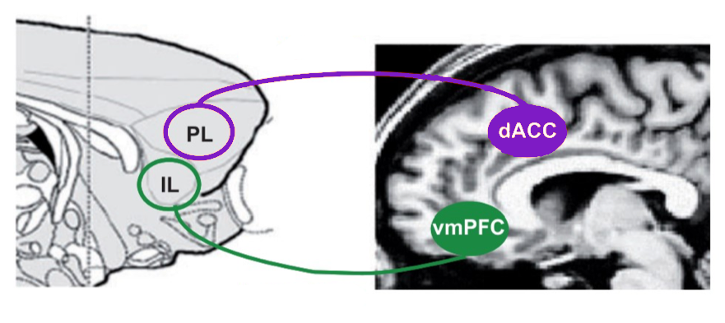


Dual role of PFC in emotional memory
Acquisition and retrieval of emotional memories involves the amygdala, hippocampus and PFC
Prelimbic and infralimbic code for memories of opposite valence
PL = Fear Acquisition
IL = Extinction
Fear Acquisition
Extinction
Milad & Quirk, 2012. Annu. Rev. Psychol.
Notes:
We have a very specific hypothesis of where we expect neural reinstatement of fear and extinction memories in the human brain. Previous research in animal models suggest that different areas of the PFC code for memories of opposite valance, and there is converging evidence from human research that suggests the same is true in humans. Specifically, the dorsal anterior cingulate cortex (dACC) codes for fear memories, and the ventro-medial prefrontal cortex codes for extinction memories. However most of the work in humans has only used univariate measures, and has not looked for neural reinstatement.
Engram studies in rodents focus mainly on the hippocampus, as the specific flavor of classical conditioning used is context conditioning.
We know that learning of both threat and safety depend on a circuit that includes the amygdala, hippocampus and the pre-frontal cortex.
Replace “more/less”
Label mouse and human (picture or word)

Slide 5
Research question & prediction
Are associative emotional memories organized the same way in the humans as in rodents?
-Goal-
Identify stable & separable representations of acquisition and extinction across the PFC
dACC
vmPFC
Neural Reinstatement
Acquisition
Extinction
Acquisition
Extinction
Notes:
This leads us to our specific hypothesis – due to the functional separation in affective processing in the PFC, there will be a double dissociation of emotional memory reinstatement. FULL STOP.
Specifically, we predict that extinction memories are preferentially reinstated in the vmPFC, and conditioning memories are preferentially reinstated in the dACC.
Maybe two slides
Additionally, we considered whether individuals with PTSD display dysregulated reinstatement of emotional memories across these regions.
With more words transition from healthy prediction to PTSD prediction

Slide 6
Research question & prediction
Are associative emotional memories organized the same way in the humans as in rodents?
-Goal-
Identify stable & separable representations of acquisition and extinction across the PFC
Heathy
PTSD
vmPFC
dACC
vmPFC
dACC
?
Neural Reinstatement
Neural Reinstatement
Extinction
Extinction
Extinction
Acquisition
Extinction
Acquisition
Acquisition
Acquisition
Notes:
This leads us to our specific hypothesis – due to the functional separation in affective processing in the PFC, there will be a double dissociation of emotional memory reinstatement. FULL STOP.
Specifically, we predict that extinction memories are preferentially reinstated in the vmPFC, and conditioning memories are preferentially reinstated in the dACC.
Maybe two slides
Additionally, we considered whether individuals with PTSD display dysregulated reinstatement of emotional memories across these regions.
With more words transition from healthy prediction to PTSD prediction

Slide 7
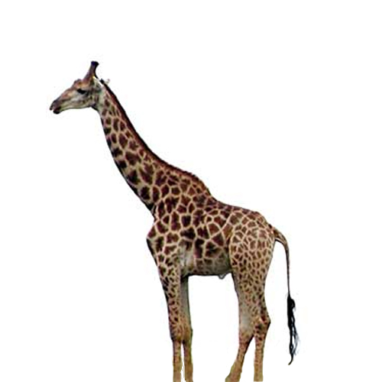



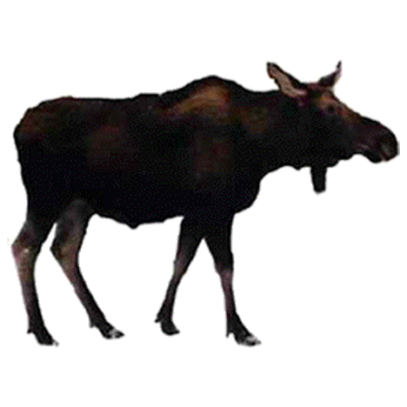





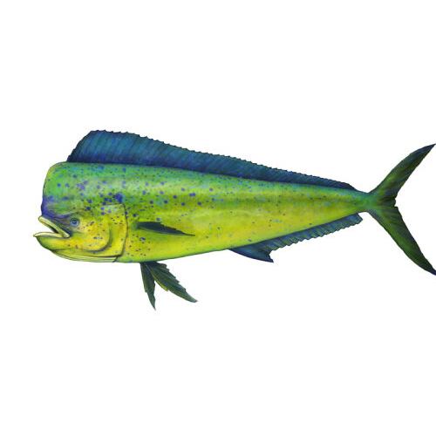


Experimental design
Unlike in rodent models, cannot physically ”tag” neural engrams
Can approximate such a tag using episodic-associative hybrid task
Surprise Recognition
Memory Test
+
+
+
--24hrs--
+
+
+
+
+
Baseline
+
Def Old
Def New
Maybe Old
Maybe New
Animal
or
Tool?
Acquisition 50% CS+US reinforcement
Extinction
No threat of shock
CS+,
CS- = animals, tools
Notes:
144 old and 96 new foils
In order to test our hypotheses, we employed an episodic-associative hybrid task. In this task, participants form an emotional association to a sematic category, either animals or tools. However, each individual stimulus is a unique category exemplar, for example, there is only 1 type of dog shown. This means that each stimulus is encoded in a distinct emotional context, based on the type of associative learning taking place.
The task starts with a baseline phase, in which participants are passively viewing the stimuli. During fear acquisition, 50% of the images from one category are paired with a mild electric shock to the wrist. Extinction immediately following fear acquisition, during which no shocks are delivered. The following day, participants are placed back in the scanner and complete a surprise recognition memory test for the items they saw the previous day.
The end result of this task is that each episodic memory has 1 implicit emotional association (none,fear, or safety).

Slide 8
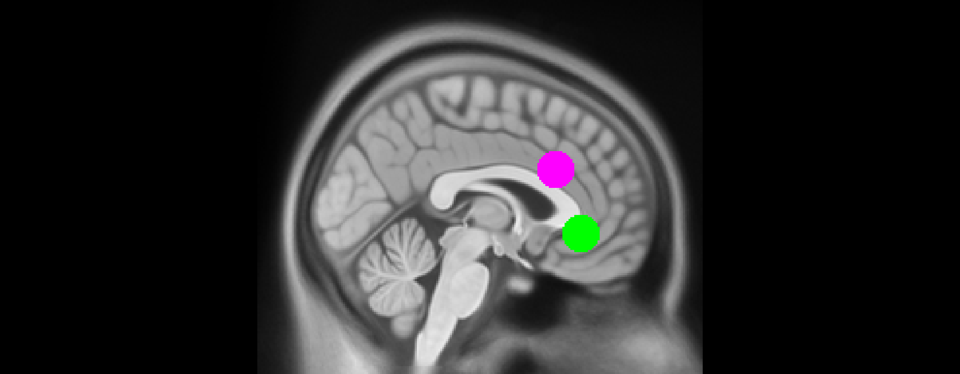
Analysis
N = 24 Healthy Controls
N = 24 PTSD
Regions of Interest
Encoding Phase
Emotional Valence
Baseline
CS+
Acquisition
CS-
Early Extinction
Extinction
Late Extinction
Milad et al., 2007. Biol. Psychiatry Fullana et al., 2018. Neurosci. Biobehav. R.
Notes:
Title needs work “methods/analysis
Say something about fMRIprep

Slide 9
Measuring encoding retrieval similarity
Encoding
-24hrs-
Retrieval
Baseline
Baseline
Acquisition
Acquisition
Extinction
Extinction
Neural Activity
Low
High

Slide 10
Measuring encoding retrieval similarity
Encoding
Representational Similarity Matrix
-24hrs-
Retrieval
Baseline
Pearson’s r
Baseline
Weak
Strong
Acquisition
Acquisition
Extinction
Extinction
Neural Activity
Low
High

Slide 11

Measuring encoding retrieval similarity
Controls - dACC
Encoding
Fisher Z(correlation)
Retrieval
Encoding
Retrieval
Notes:
Add encoding/retrieval labels to this
Start with EE and RR and then pop out ER

Slide 12
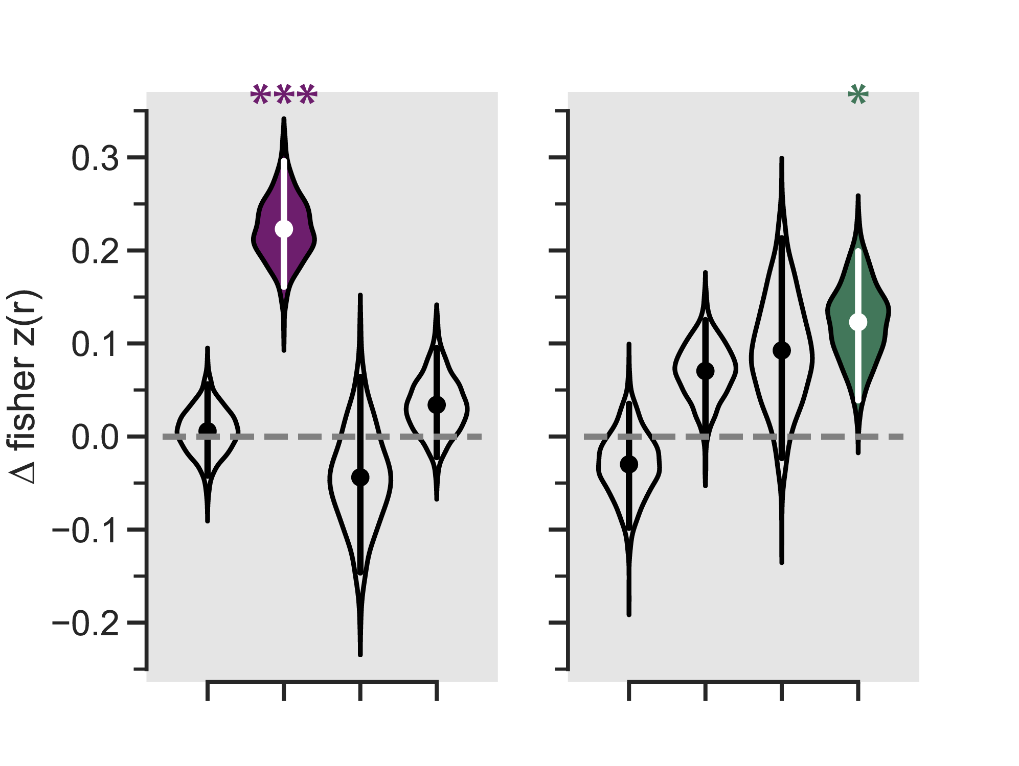
Emotional memory reinstatement
CS+ – CS-
dACC
vmPFC
Baseline
Early
Late
Baseline
Early
Late
Acquisition
Extinction
Acquisition
Extinction
FDR corrected within group
Notes:
“engram like” activity
As we predicted + interpretation
2 slides, BIG pause after controls to let that sink in

Slide 13
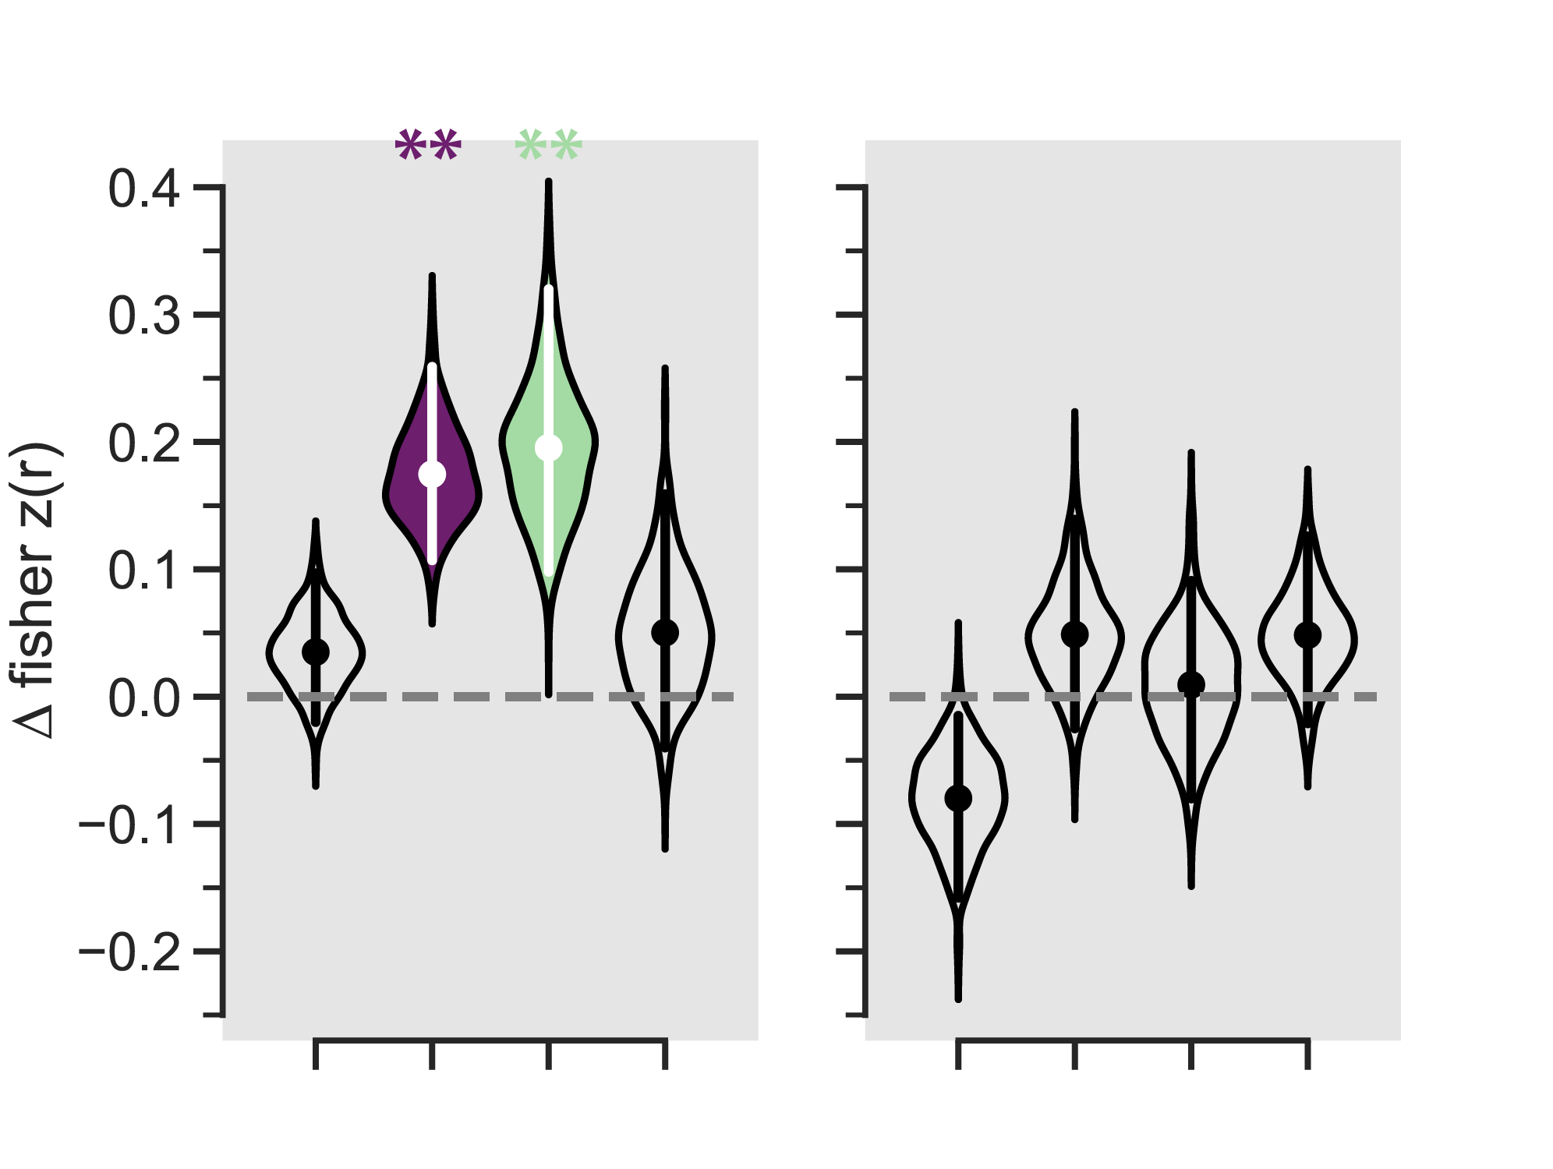
Emotional memory reinstatement
CS+ – CS-
Control
PTSD
dACC
vmPFC
dACC
vmPFC
Baseline
Early
Late
Early
Late
Early
Late
Early
Late
Acquisition
Baseline
Baseline
Baseline
Acquisition
Acquisition
Acquisition
Extinction
Extinction
Extinction
Extinction
FDR corrected within group
Notes:
“engram like” activity
As we predicted + interpretation
2 slides, BIG pause after controls to let that sink in
Main effects of roi and encoding phase
Interaction of roi X encoding phase, group X Roi
Group x encoding phase X ROI

Slide 14
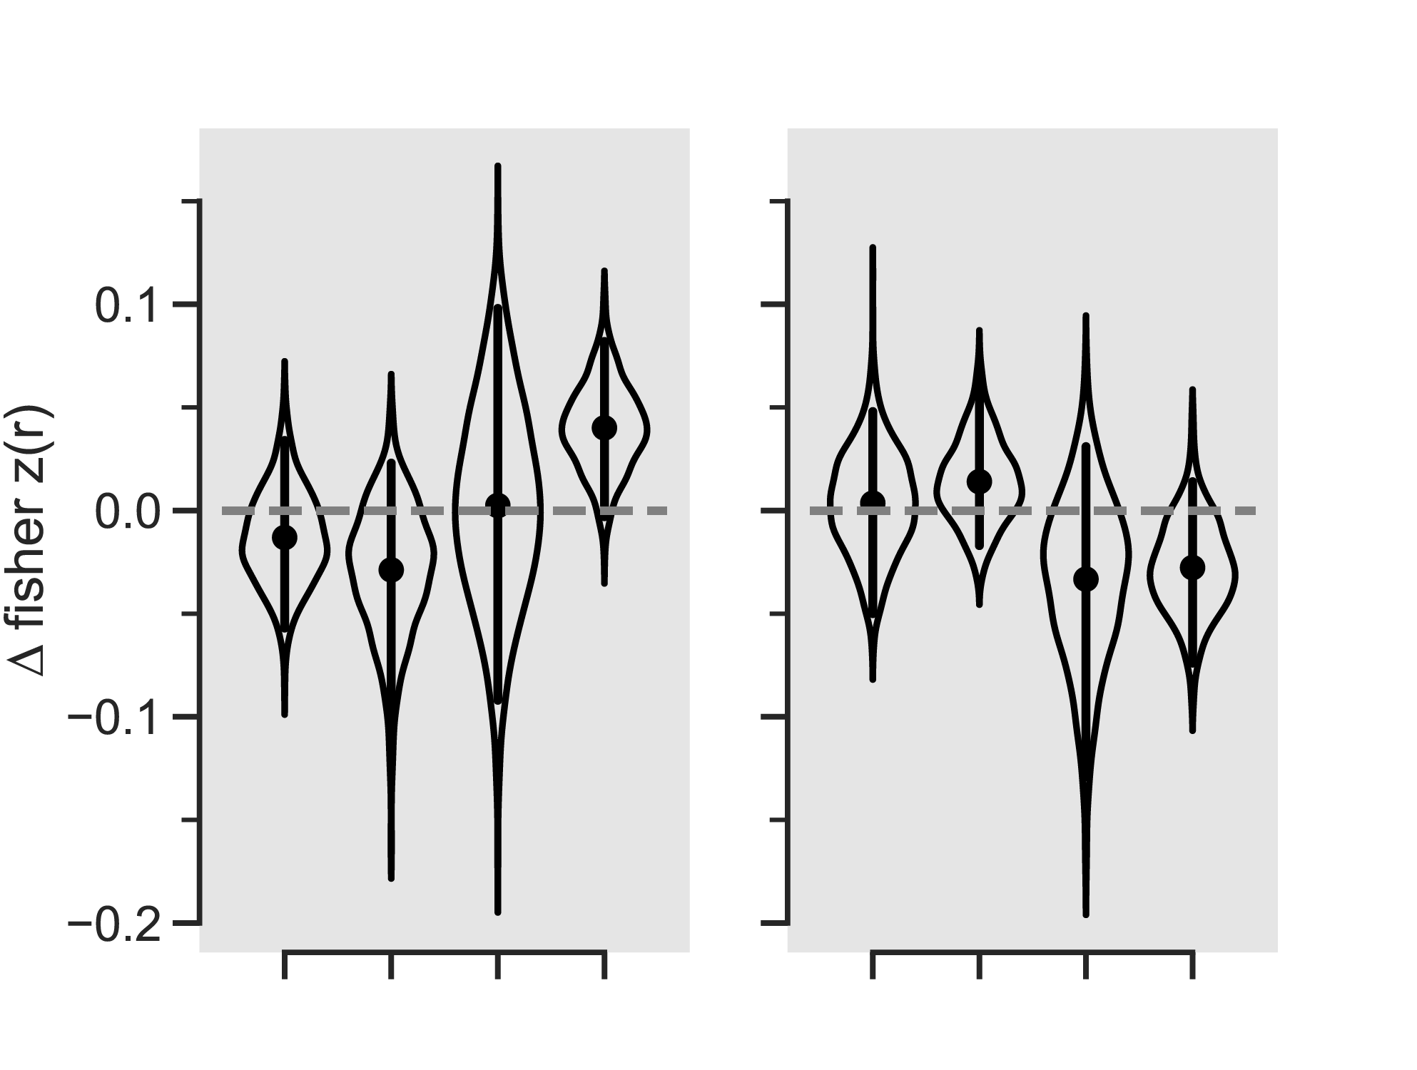
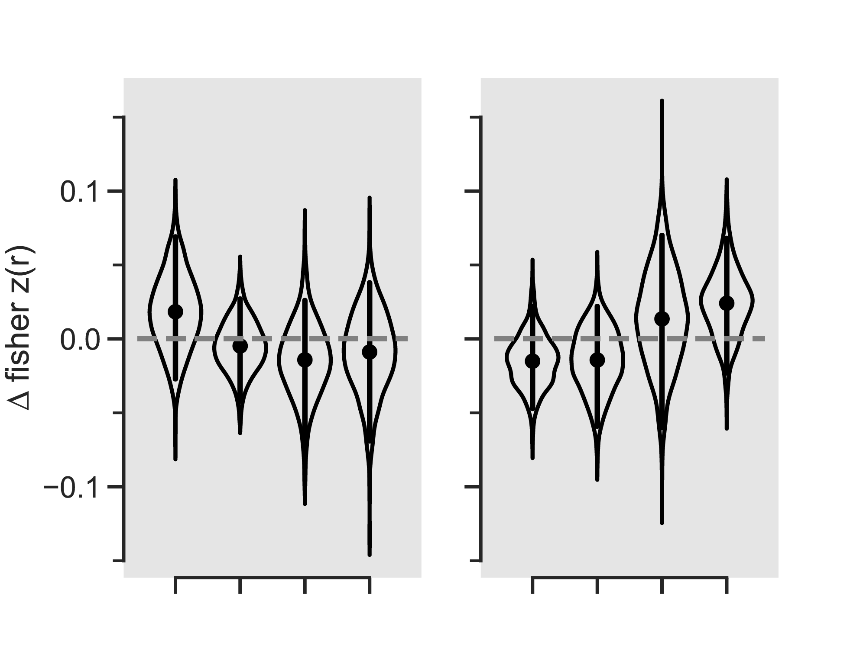
No emotional reinstatement in subcortical ROIs
Healthy
PTSD
Hippocampus
Amygdala
Hippocampus
Amygdala
Baseline
Early
Late
Early
Late
Acquisition
Extinction
Baseline
Acquisition
Extinction

Slide 15
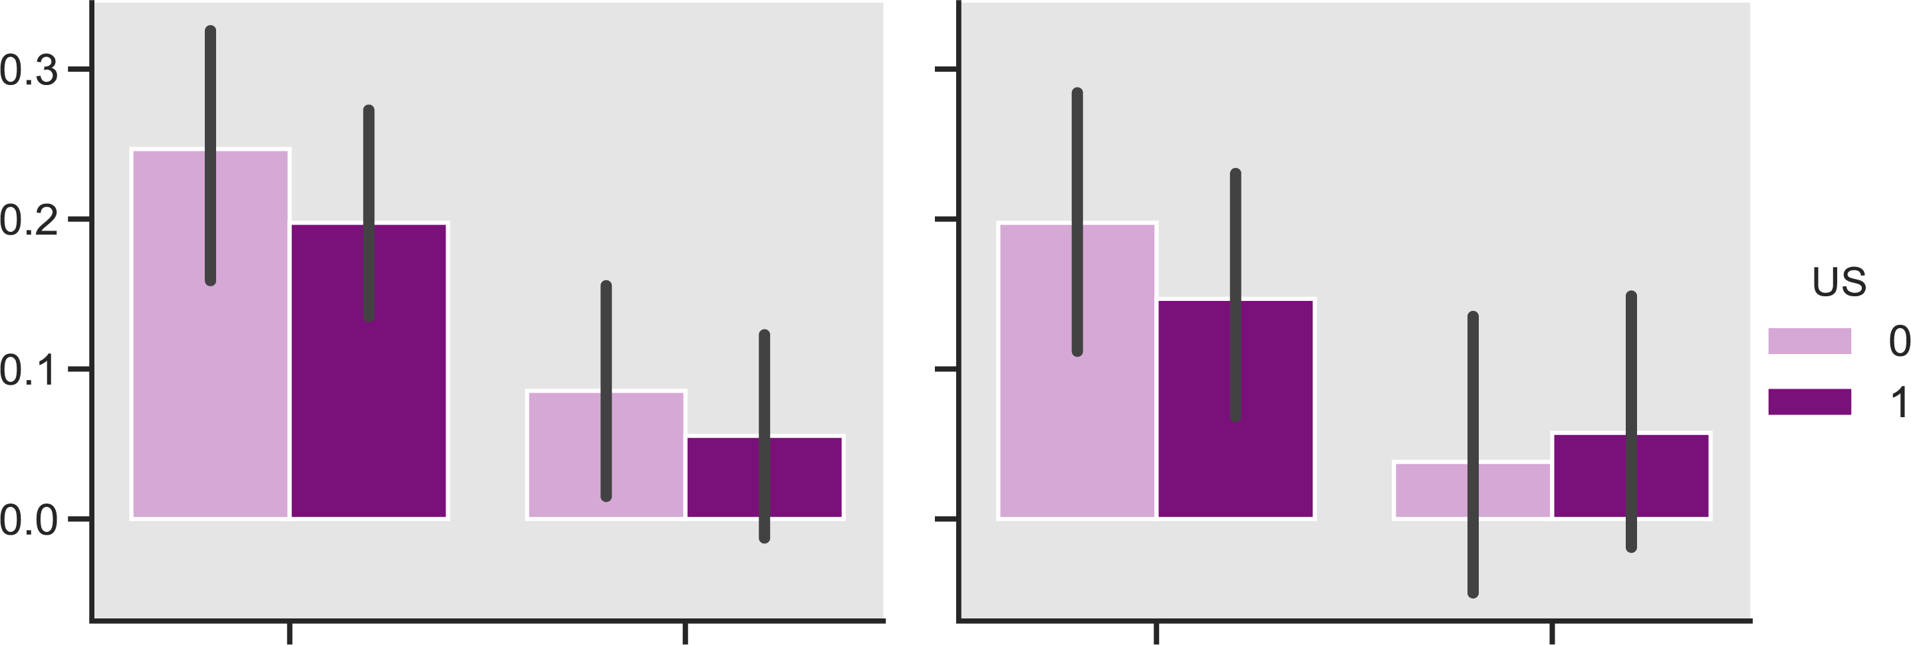
No effect of US reinforcement
CS+ – CS-
Healthy
PTSD
No
Yes
dACC
vmPFC
dACC
vmPFC
Main effect of ROI: F(1,46) = 16.86, p<.001
No effect of US: F(1,46) = 3.67, p=0.061

Slide 16
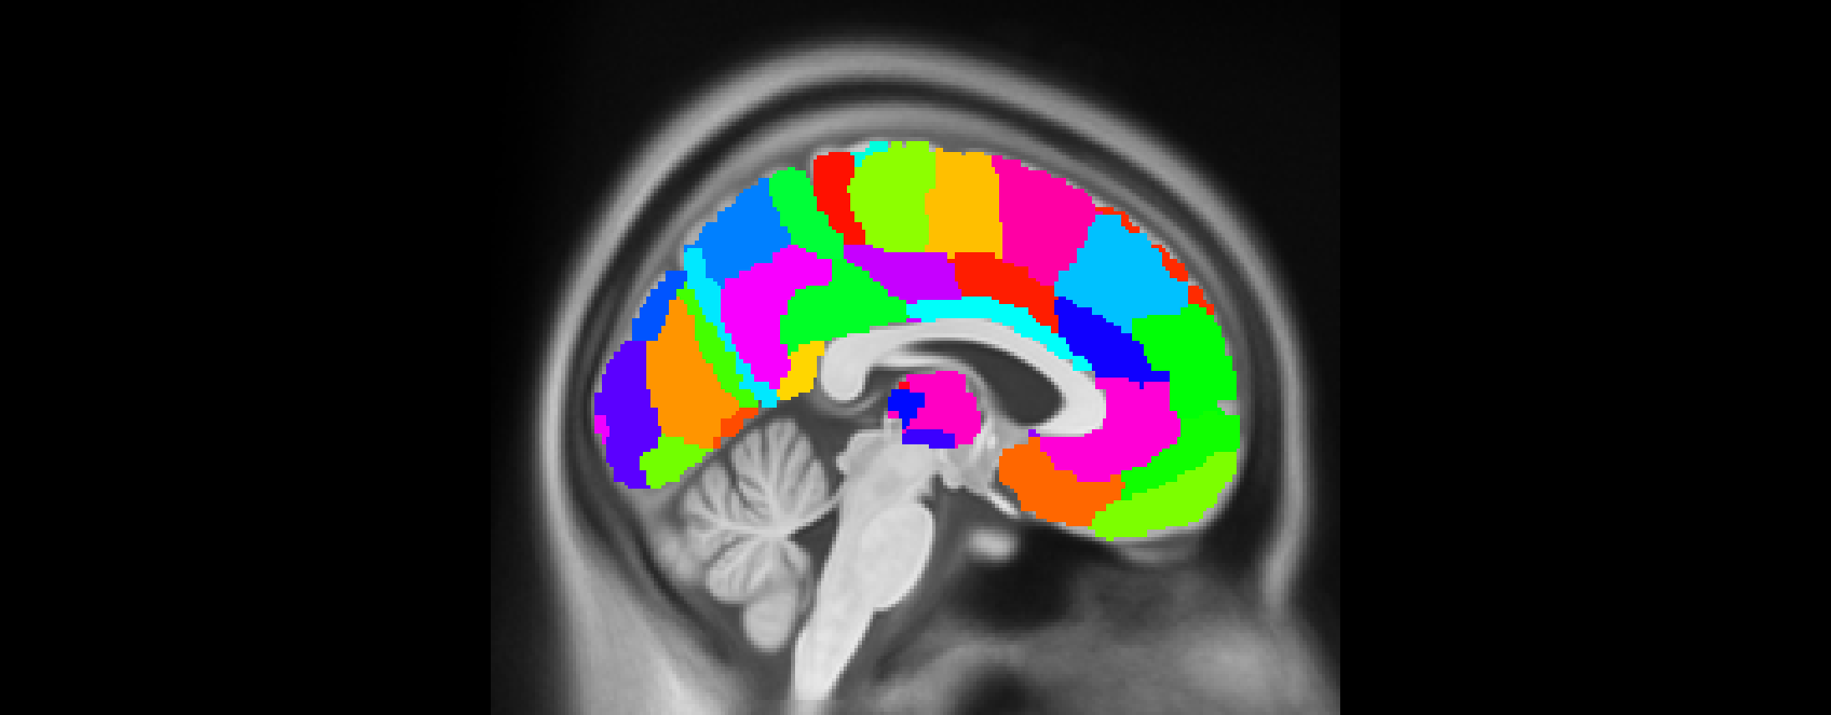
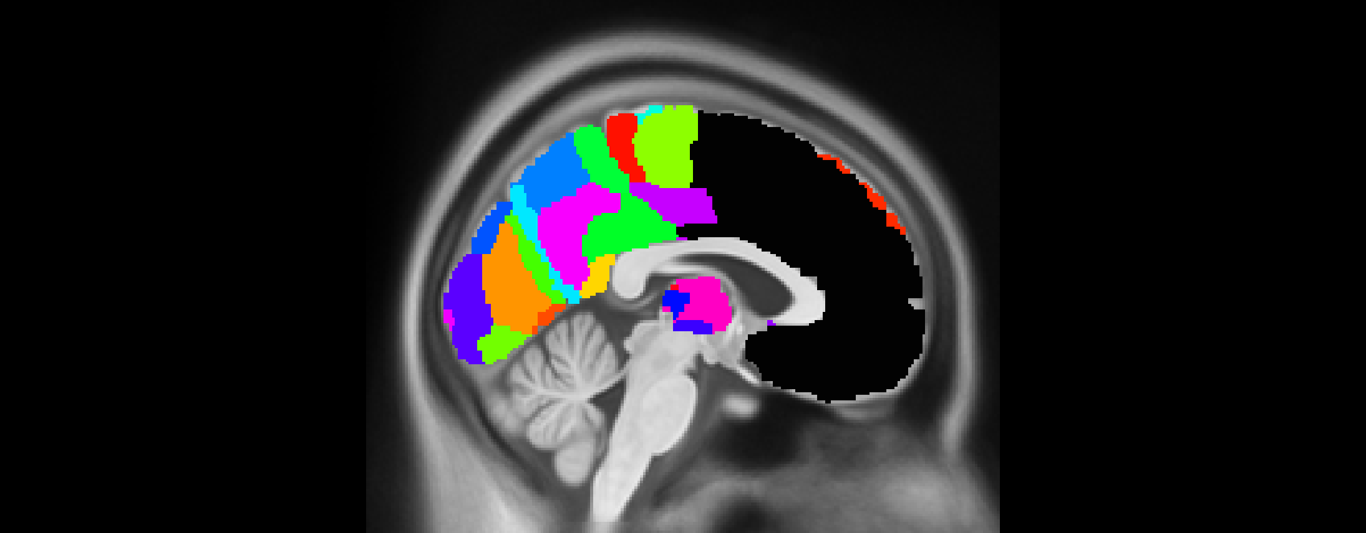
Wider look at PFC
Brainnetome atlas – fine grained parcellation of cortex
11 bilateral ROIs from frontal & limbic lobes, along the midline
x = 3

Slide 17
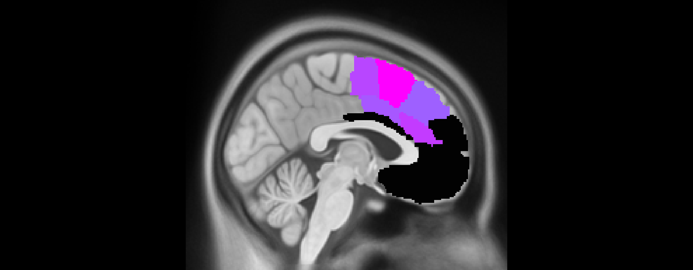
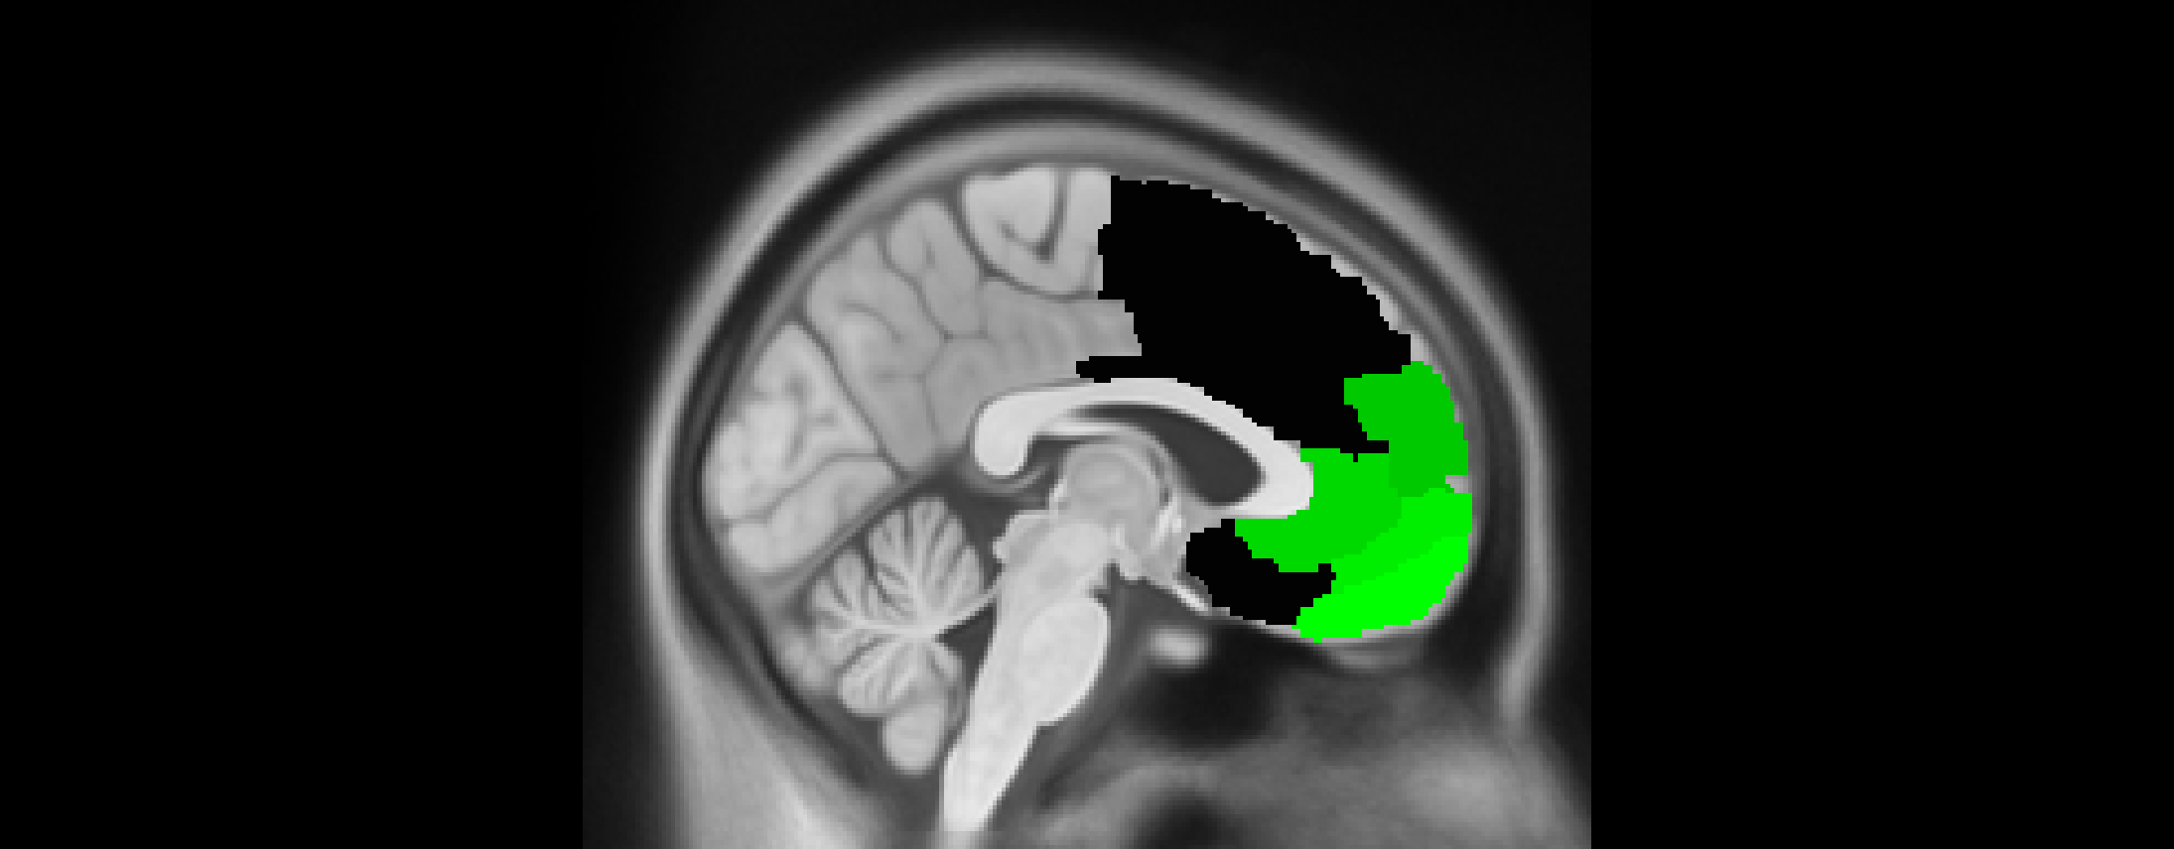
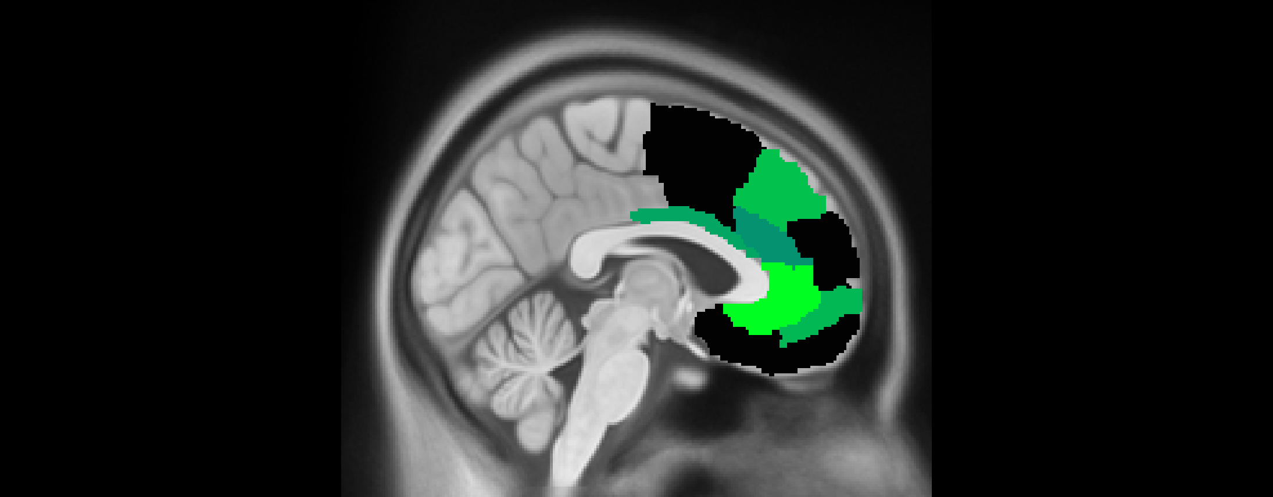


Wider look at PFC
CS+ – CS-
Healthy
PTSD
x = 3
Acquisition
Early
Late
Acquisition
Early
Late
Extinction
Extinction
Each image threshold at p<.05 FDR corrected
Lighter color corresponds to higher t-value (one-sided against 0)

Slide 18
Interim Summary – neural reinstatement
dACC
vmPFC
Dissociable reinstatement in PFC of
emotional memories in healthy adults
Individuals with PTSD misallocate
early extinction memories to dACC
(a priori ROI)

Slide 19
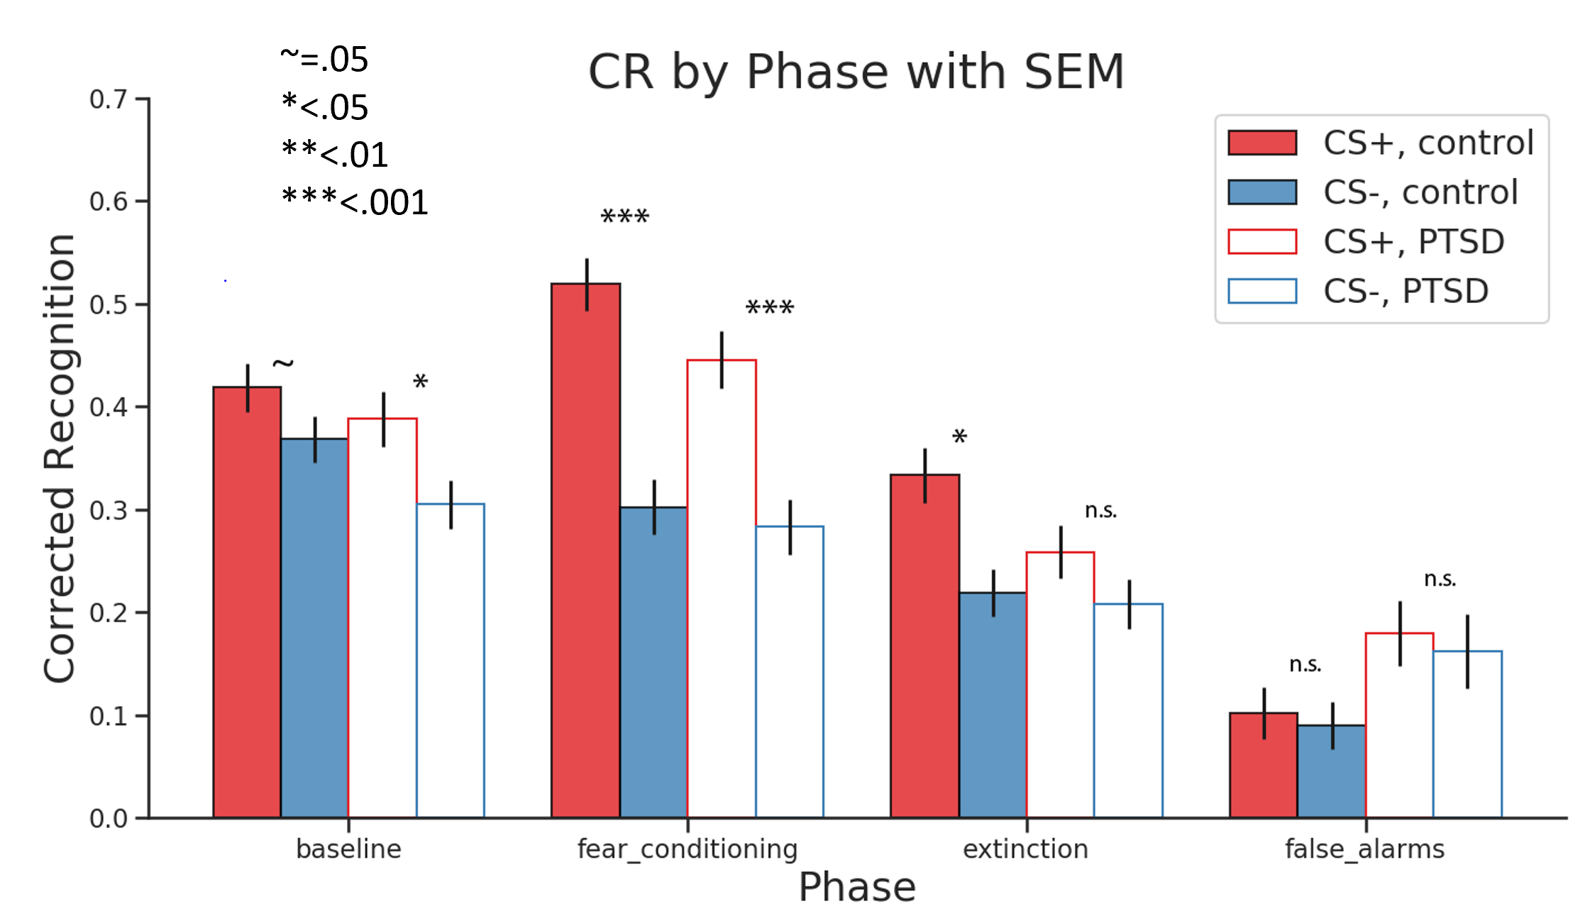
Behavioral Results – Recognition Memory
No main effect nor interaction of group
Notes:
No main effect nor interaction of group

Slide 20
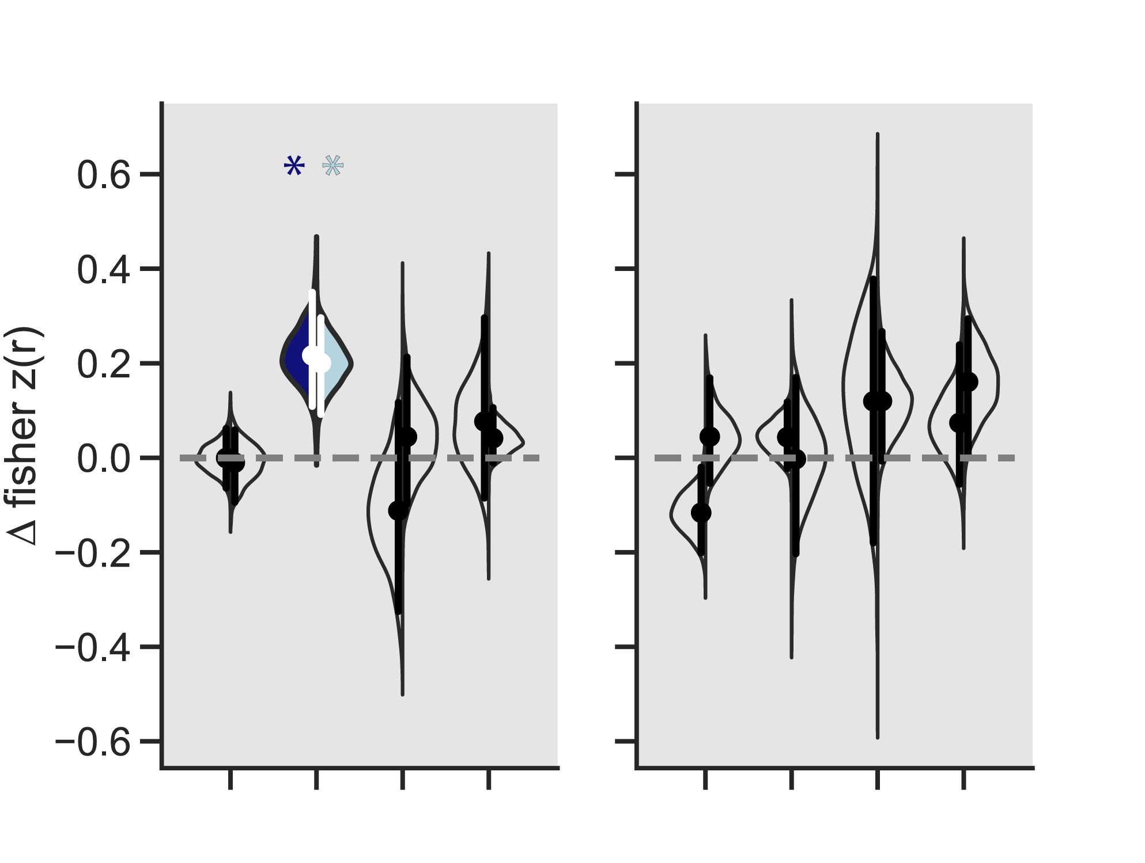
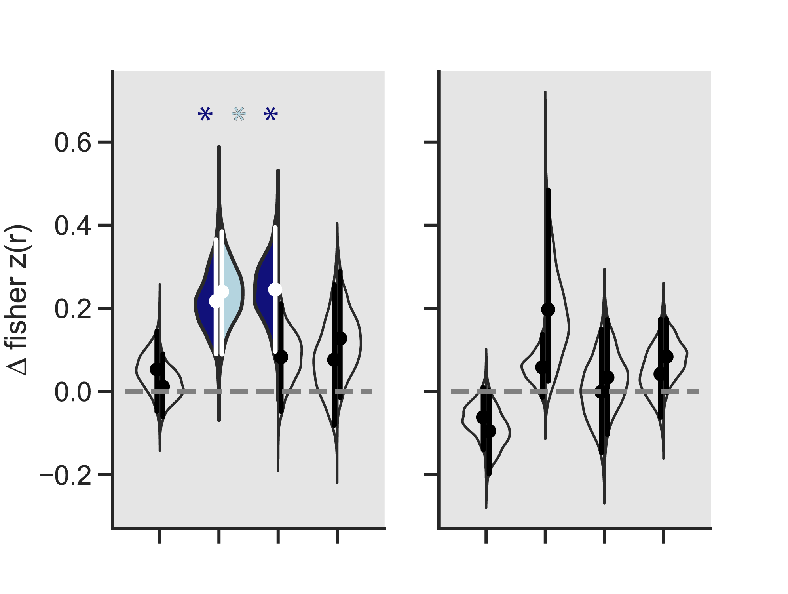
Influence of episodic memory
CS+ – CS-
Recognition Memory
HIT
PTSD
Healthy
MISS
dACC
vmPFC
dACC
vmPFC
Baseline
Early
Late
Baseline
Early
Late
Acquisition
Extinction
Acquisition
Extinction
FDR corrected within group
Notes:
CANT run an ANOVA – missing values

Slide 21
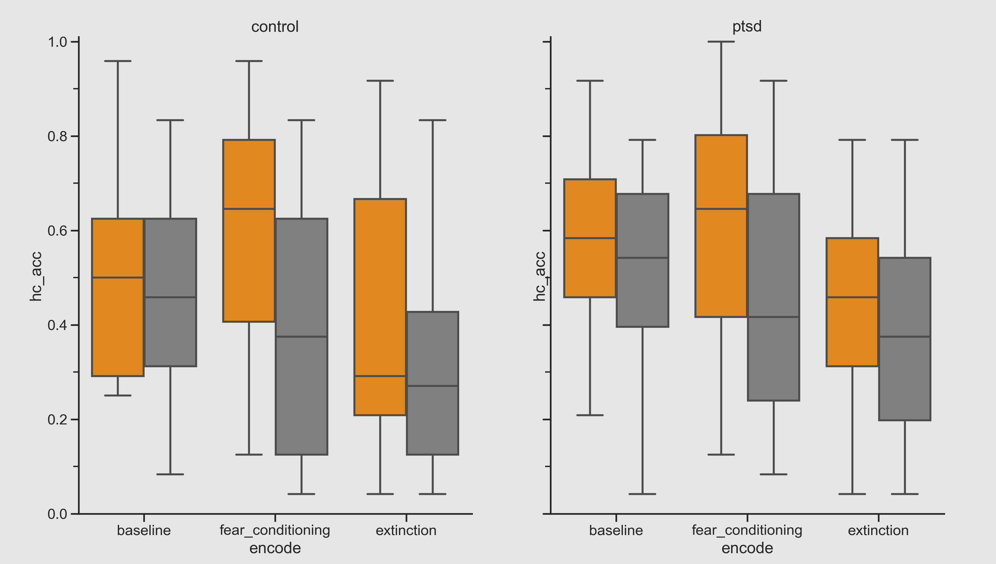
Behavior – Hit Rates
CS+
CS-
Main effects of encoding phase and CS type
Interaction of encoding phase X CS type

Slide 22
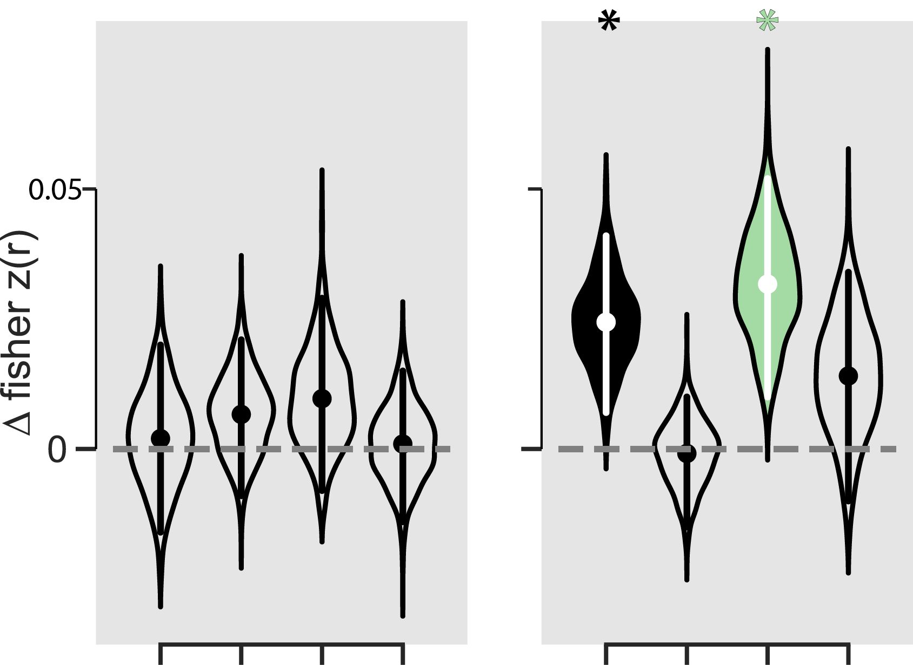
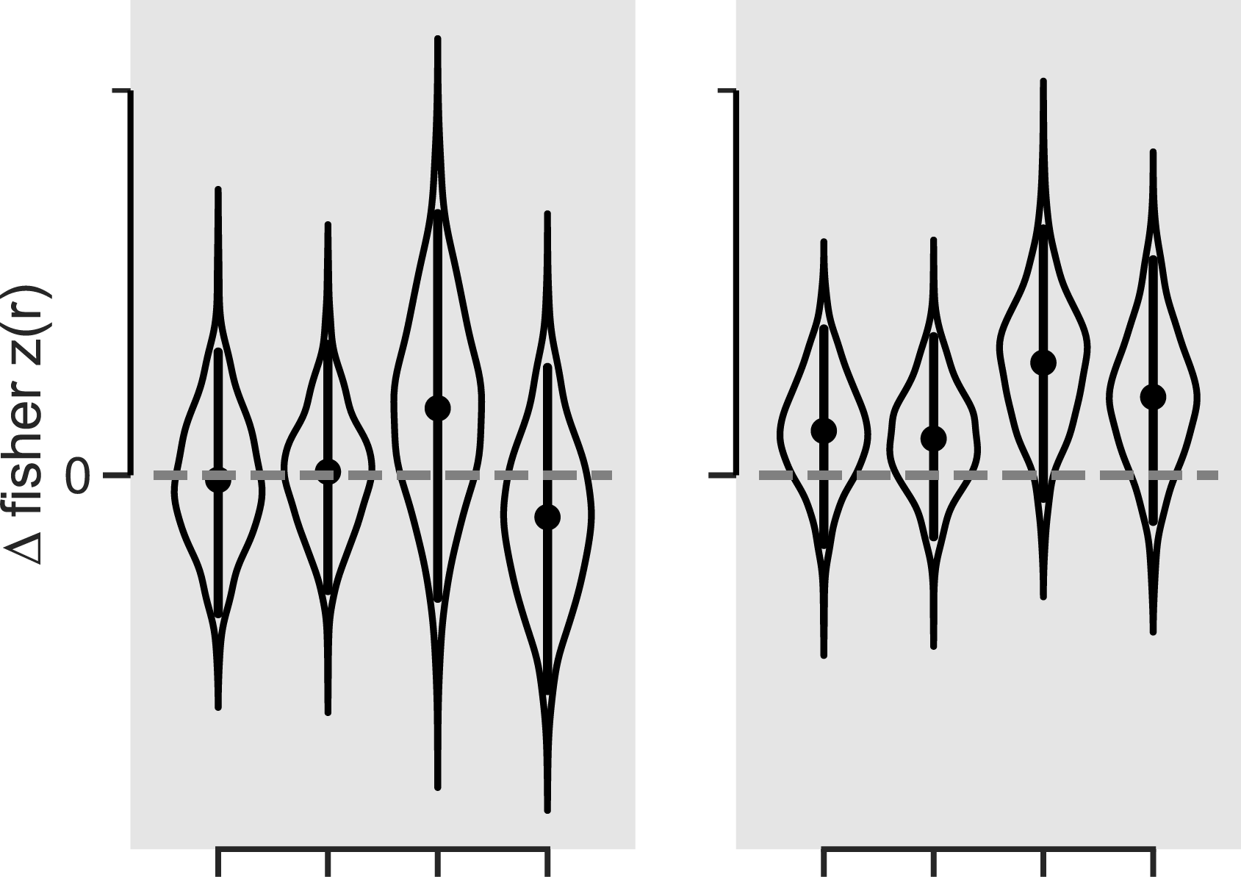
RSA to novel foils
CS+ – CS-
Healthy
PTSD
dACC
vmPFC
dACC
vmPFC
Baseline
Early
Late
Baseline
Early
Late
Acquisition
Extinction
Acquisition
Extinction
FDR corrected within group
Notes:
Main effect of ROI is trending, but otherwise nothing
Need to look at this based on correct rejections vs. false alarms
Also absolutely nothing in subcortical

Slide 23
Interim Summary – memory
Selective reinstatement of fear memories are reinstated in the dACC regardless of memory episodic memory
Betters ways of pursuing this?
For healthy adults, vmPFC some selective RSA for novel foils
Need to investigate correct rejections vs. false alarms
Notes:
This pattern was not observed in PTSD individuals
dACC shows significant ERS for extinction memories – misallocation

Slide 24
What mechanism supports reinstatement in PFC?
Functional connectivity - gPPI
FSL, with SPM deconvolution to get neuronal signal
First pass analysis focuses on connections between our PFC ROIs, and the hippocampus and amygdala
Comparison is CS+ acquisition vs. CS+ encoding
Retrieval, and encoding
Ignoring memory status, also does not reflect early vs. late extinction

Slide 25
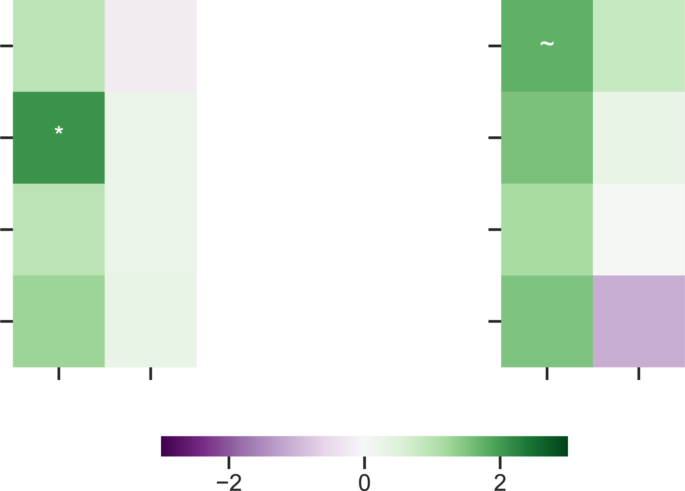
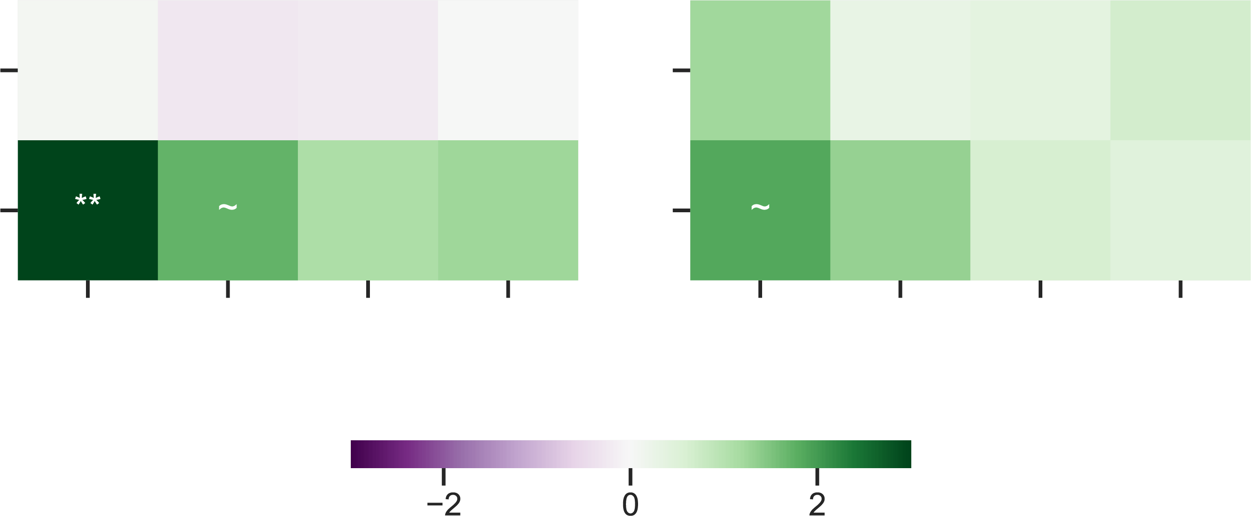
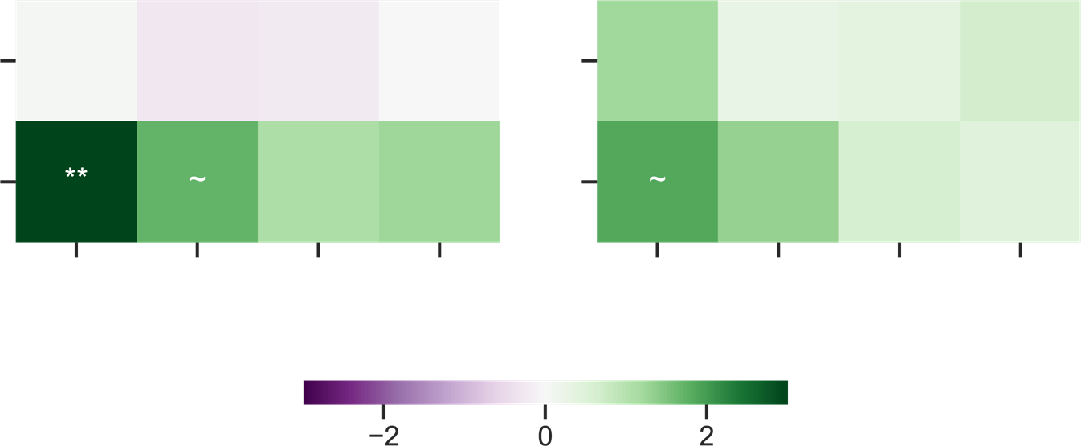
gPPI – retrieval
Healthy
PTSD
Target
Healthy
PTSD
Target
Rh Hpc
dACC
Lh Hpc
vmPFC
Rh Amyg
Rh Hpc
Lh Hpc
Rh Amyg
Lh Amyg
Lh Amyg
Seed
dACC
vmPFC
Seed
t statistic (two-tailed)
CS+ Acquisition
CS+ Extinction

Slide 26
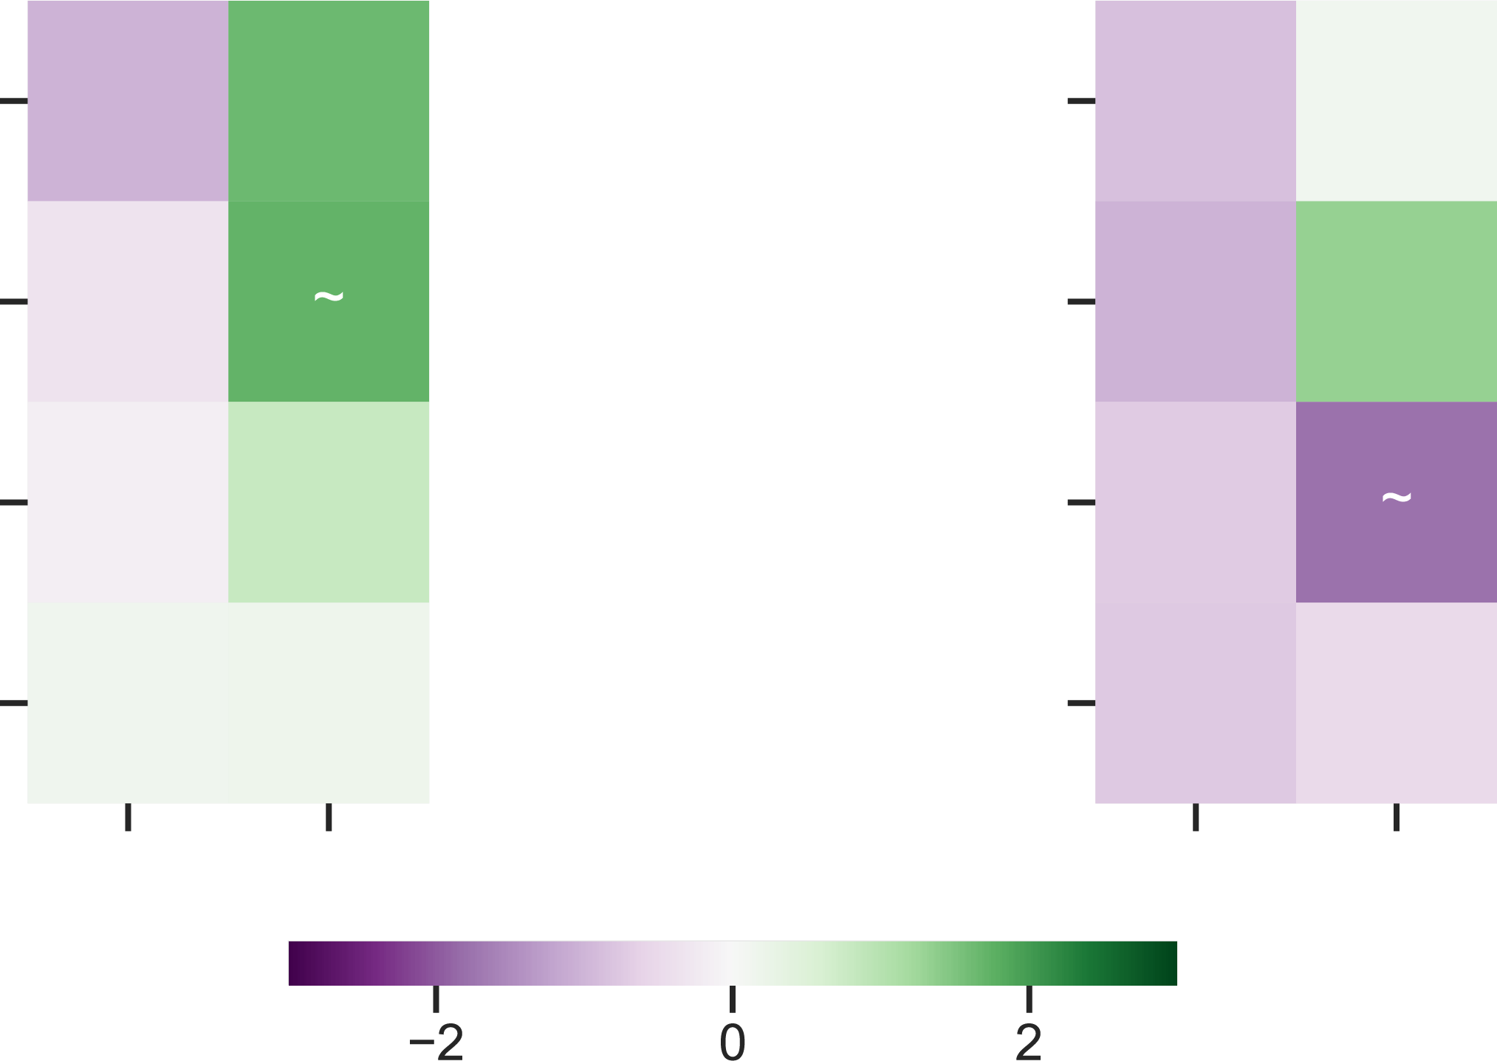
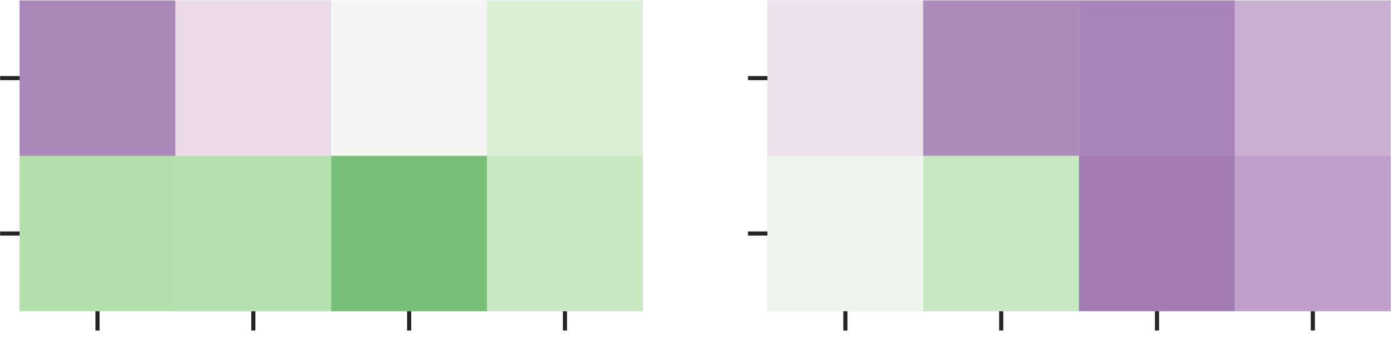
gPPI – encoding
Healthy
PTSD
Target
Healthy
PTSD
Target
Rh Hpc
dACC
Lh Hpc
vmPFC
Rh Amyg
Rh Hpc
Lh Hpc
Rh Amyg
Lh Amyg
Lh Amyg
Seed
dACC
vmPFC
Seed
t statistic (two-tailed)
CS+ Acquisition
CS+ Extinction

Slide 27
Final Summary - gPPI
During retrieval, healthy adults show Hpc -> vmPFC connectivity for extinction CS+ items
Possible future analyses
Directly relate connectivity measures to the ERS
Reinstatement of “patterns of connectivity”
Expanding to entire PFC

Slide 28
Acknowledgements
Dunsmoor Lab
Lewis-Peacock Lab
Joey Dunsmoor, Ph.D.
Emily Leiker, Ph.D.
Sam Cooper, Ph.D.
Carola Salvi, Ph.D.
Augustin Hennings
Nicole Keller
Mason McClay
Jarrod Lewis-Peacock, Ph.D.
Elizabeth Lorenc, Ph.D.
Hyojeong Kim
Seth Koslov
Remington Mallett
Augustin Hennings
Allison Bruning
Justin Kilmary
Zachary Bretton
Sydney Fischer
& Many talented undergraduate RAs

